Slide 1
WATER POTABILITY PREDICTION
PRESENTED BY
FARZANA M R

Slide 2
INTRODUCTION
Access to safe drinking water is essential for human health and survival. Water contamination can lead to serious health risks and diseases.
Traditional water quality testing:
Requires laboratory analysis
Time-consuming
Expensive
Not always accessible

Slide 3
PROBLEM STATEMENT
Problem
Determine whether water is Potable (Safe) or Not Potable.
Based on chemical and physical parameters.
Manual analysis is slow and error-prone.
Solution
Machine Learning classification models.
Real-time prediction API.
Interactive visualisation dashboard.

Slide 4
DATASET FEATURES
Input Features
pH
Hardness
Solids
Chloramines
Sulfate
Conductivity
Organic Carbon
Trihalomethanes
Turbidity
Target Variable
Potability (0 = Not Potable,
1 = Potable)

Slide 5
DATA PREPROCESSING & MISSING VALUE HANDLING
Examined dataset dimensions and feature types
Analysed descriptive statistics
Identified missing values across features
⚙ Data Cleaning Strategy
Addressed missing values in:-pH, Sulfate, Trihalomethanes
Applied statistical imputation methods
Ensured high-quality, complete dataset for ML pipeline

Slide 6
EXPLORATORY DATA ANALYSIS (EDA)
Distribution plots for all features
Checked skewness and spread
Identified feature patterns
Visualized relationships with target variable

Slide 7
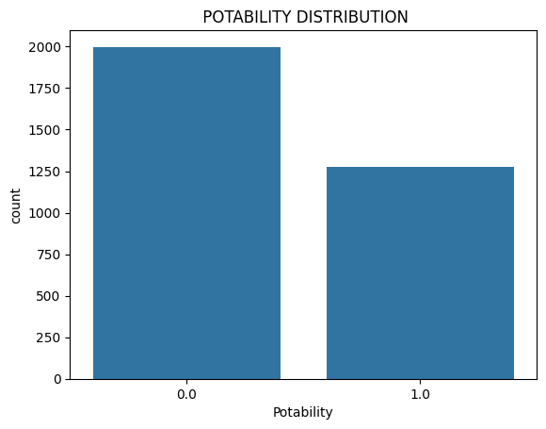
EDA VISUZLIZATION

Slide 8
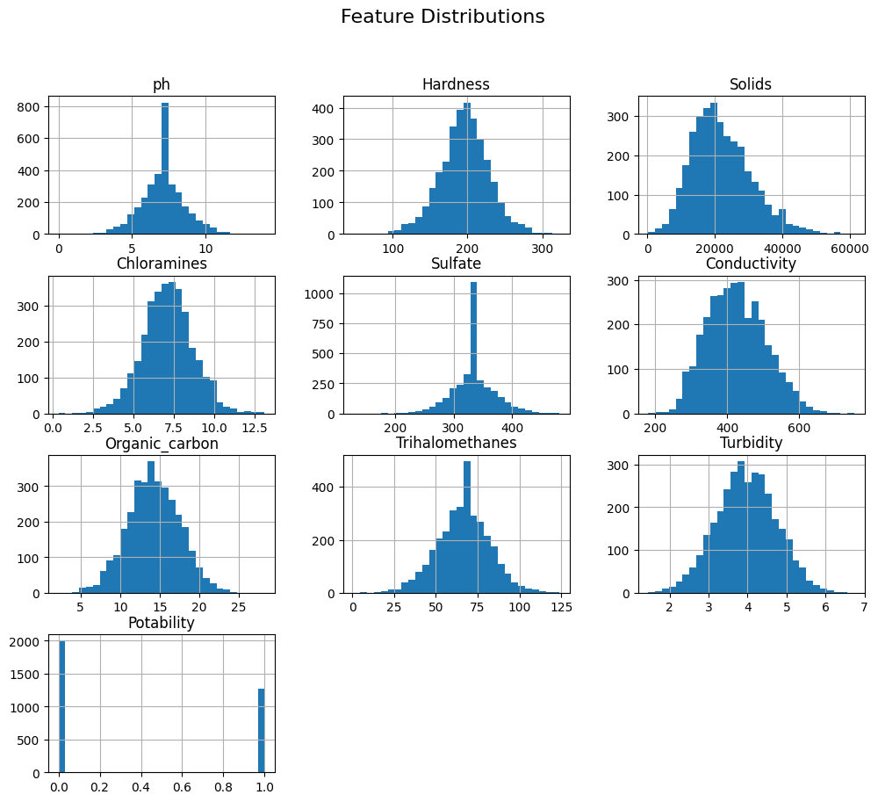
FEATURE DISTRIBUTIONS

Slide 9
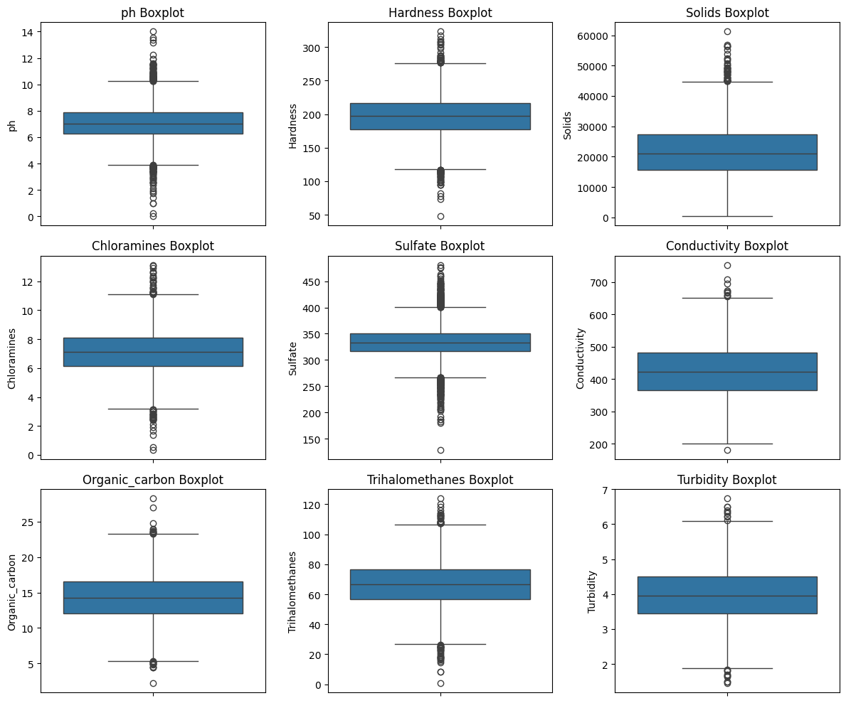
OUTLIERS

Slide 10
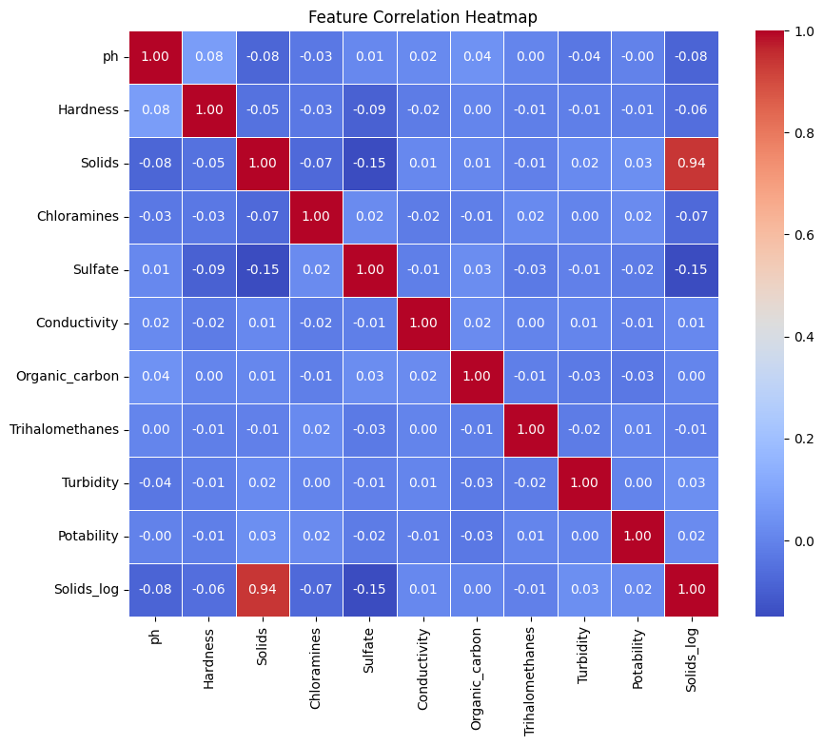
CORRELATION ANALYSIS

Slide 11
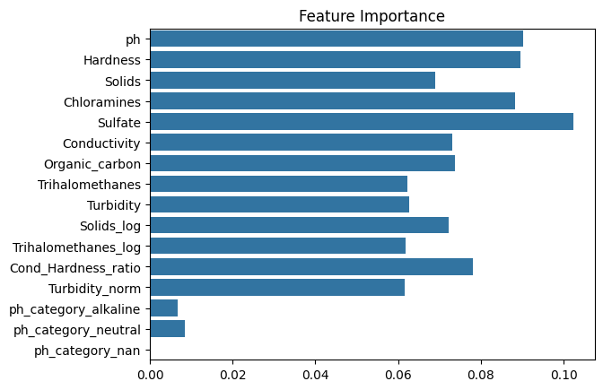
FEATURE IMPORTANCE

Slide 12
HANDLING CLASS IMBALANCE
Observed imbalance in Potability classes
Applied SMOTE (Synthetic Minority Oversampling Technique)
Balanced class distribution
Improved recall and F1-score

Slide 13
FEATURE ENGINEERING
Log transformations: Solids_log, Trihalomethanes_log
Ratio feature: Cond_Hardness_ratio
Normalization: Turbidity_norm
pH categorization + One-hot encoding
👉 Reduces skewness & improves pattern learning

Slide 14
FEATURE SCALING
Applied standardization/normalisation
Important for SVM & KNN
Prevents large-value dominance (e.g., Solids)
👉 Improves accuracy & model stability

Slide 15
MACHINE LEARNING MODELS
Models trained and saved as .pkl files:
Random Forest (Pipeline)
XGBoost
SVM
KNN
Decision Tree
Evaluation Metrics
Accuracy
Precision
Recall
F1 Score

Slide 16
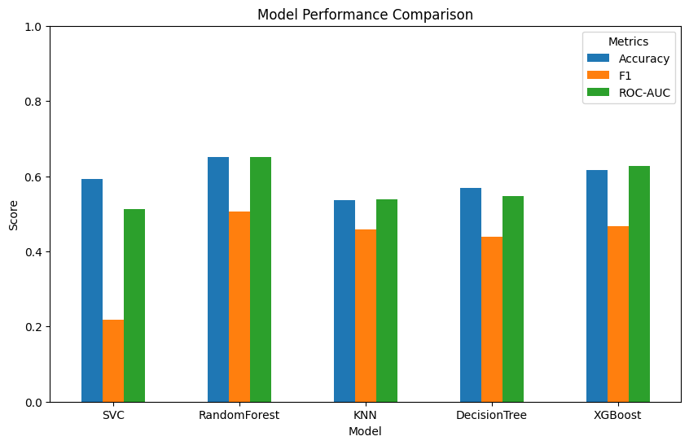
MODEL PERFORMANCE COMPARISON

Slide 17
BEST PERMORMED PERFORMANCE
Best Performing Model: RandomForest
ROC-AUC: 0.65
Accuracy: 0.65
F1 Score: 0.51

Slide 18
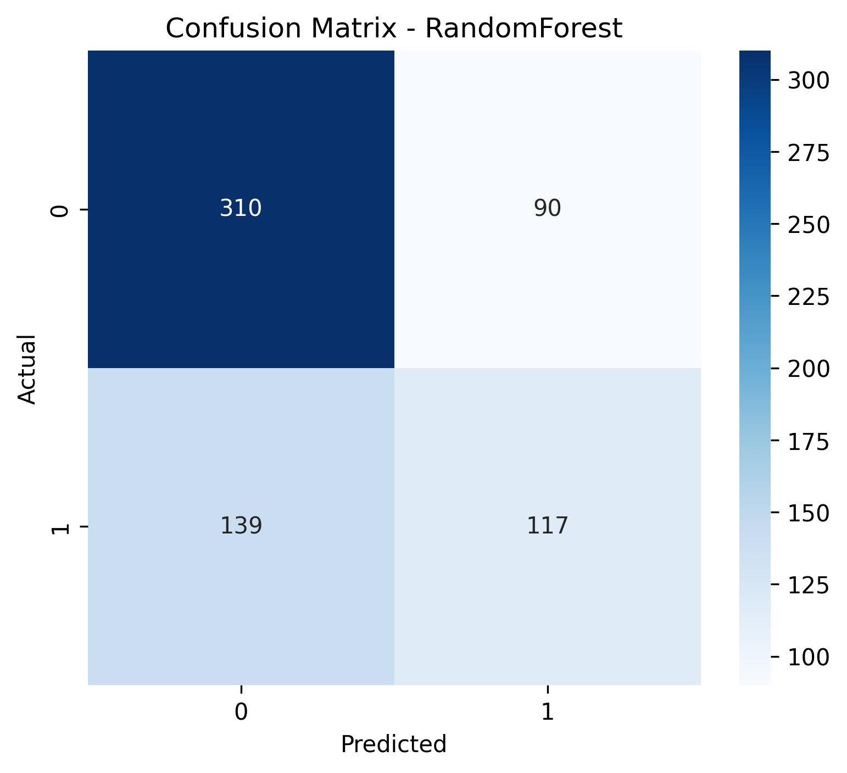
CONFUSION MATRIX

Slide 19
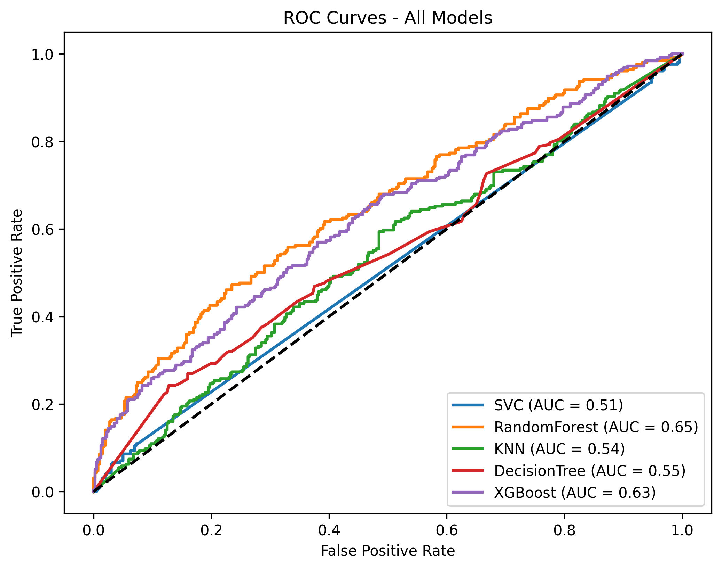
ROC CURVES

Slide 20
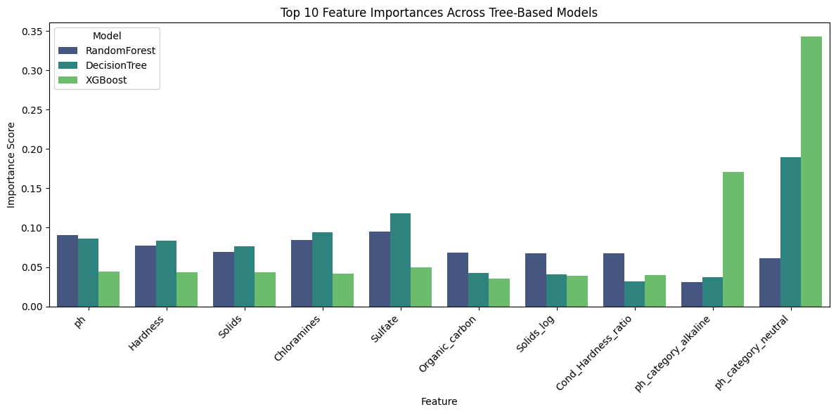
FEATURE IMPORTANCE BASED ON TREE MODELS

Slide 21
SYSTEM ARCHITECTURE
User ↓ Streamlit Frontend (app.py) ↓ FastAPI Backend (api.py) ↓ ML Models (.pkl files from notebook)

Slide 22
BACKEND: FASTAPI ARCHITECTURE
Key Features
REST API built using FastAPI
Dynamic model loading
Automatic feature engineering
Handles multiple ML models
Returns probability.

Slide 23
FASTAPI ENDPOINTS
GET Endpoints
/health → Check API status
/models → List available models
/runtime → Show Python & sklearn versions
POST Endpoint
/predict
Accepts water parameters
Returns:
Prediction
Label
Probability
Model file used

Slide 24
PREDICTION WORKFLOW
User submits input values
API:
Computes engineered features
Encodes pH category
Loads selected model
Makes the prediction.
Returns:
0 or 1
Potable / Not Potable
Probability score

Slide 25
FRONTEND: STREAMLIT APP
Modern light theme styling
Backend connection field
Model selection dropdown
Quick presets:
Typical Tap
Hard Water
Soft Water
River Water
Industrial Water
Real-time prediction button

Slide 26
CONCLUSION
Built full ML lifecycle project.
Trained multiple classification models
Deployed using FastAPI.
Built interactive dashboard,
Real-time water potability prediction system.

Slide 27
Thank You!

